Slide 1
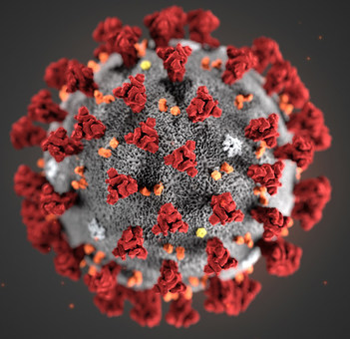
Covid-19 and the human development index
By: Nicholas Czipo

Slide 2
Project questions
How do Covid-19 case counts compare to death counts?
How did Covid-19 impact different regions of the world?
Is there a correlation between Human Development Index scores and Covid-19 rates?

Slide 3
Methodology and Data
Covid-19 data was scraped from worldometers.info
HDI data was downloaded form ourworldindata.org

Slide 4
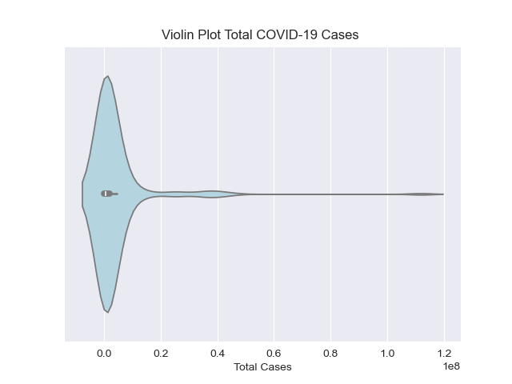
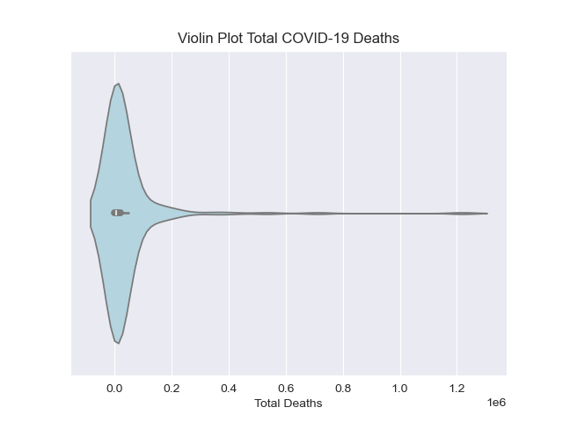
Cases vs. deaths
Mean case count: 3,736,089 vs. median case count: 463,210
Mean deaths: 37,944 vs. median deaths: 4,509

Slide 5
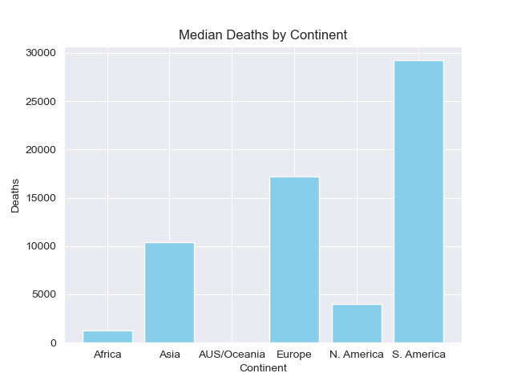
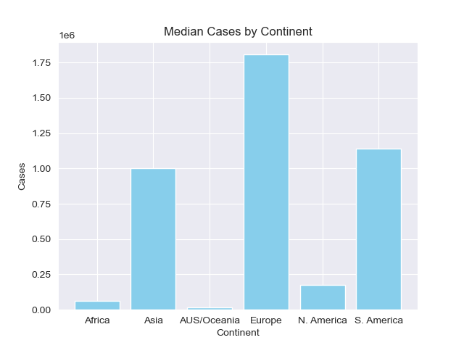
Covid by Region
Europe experienced the most cases, followed by South America
South America experienced the most deaths, followed by Europe

Slide 6
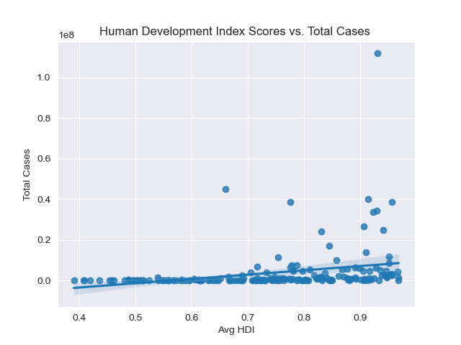
HDI and Covid cases
Weak positive correlation (0.285)
Countries with high standards of living were not spared high Covid-19 case counts

Slide 7
Future Work
Include additional explanatory variables:
Stringency Index
Population Density
Urbanization Rates

